Slide 1
Deep Learning for Image Super-resolution: A Survey
Wang, Zhihao, Jian Chen, and Steven CH Hoi. "Deep Learning for Image Super-resolution: A Survey." arXiv preprint arXiv:1902.06068 (2019).

Slide 2
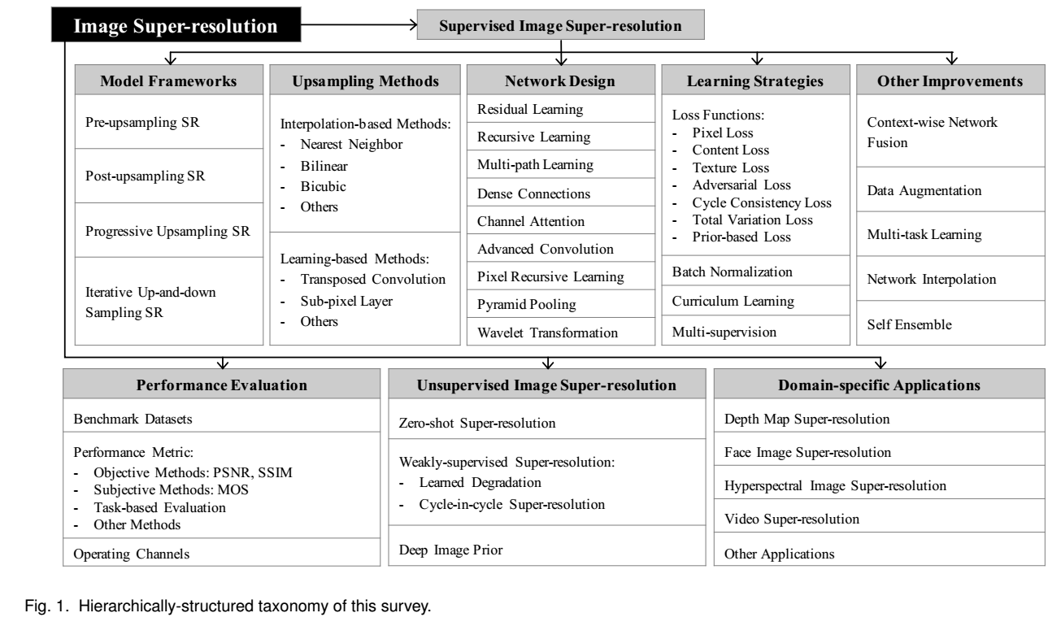

Slide 3
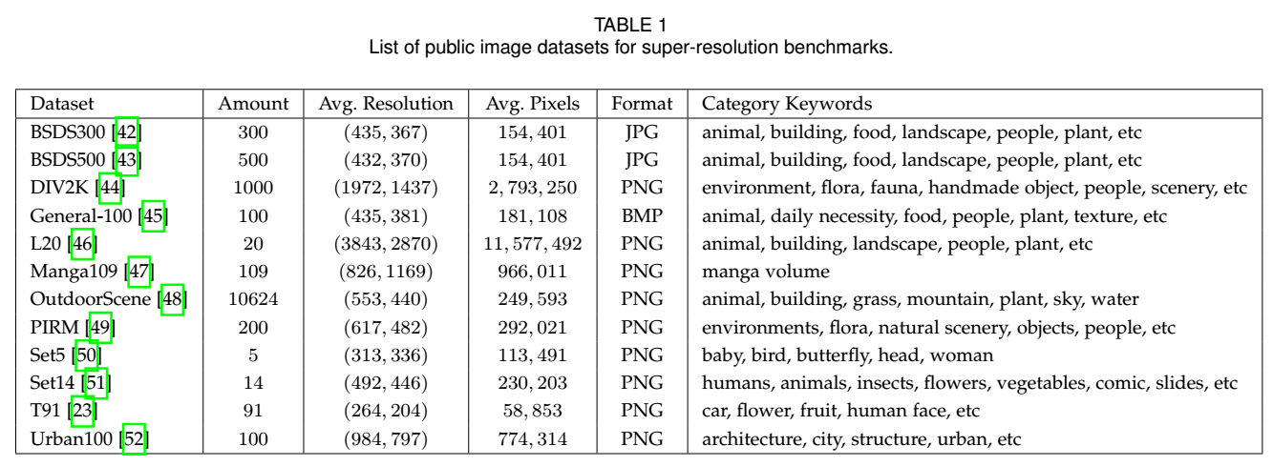
SR-related Dataset

Slide 4
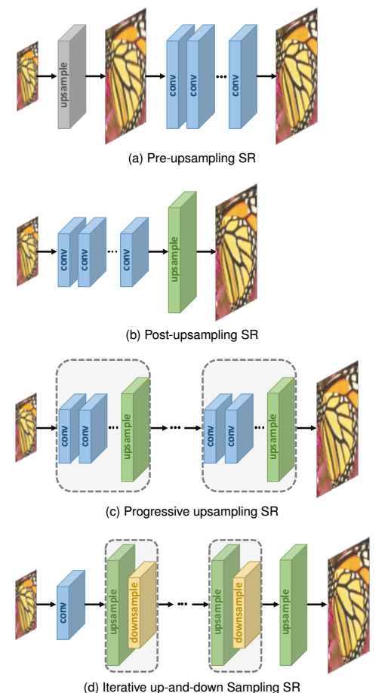
Super-Resolution Frameworks

Slide 5
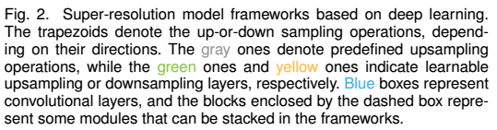
Super-resolution Frameworks

Slide 6
 | Pros | Cons
Pre-upsampling SR (e.g. SRCNN) | The difficult upsampling task has been done by predefined traditional algortihms, and deep CNNs only need to refine the coarse images, which significantly reduces the learning difficulty These models can take interpolated images with arbitrary size and scaling factors as input, and the refined results with comparable performance to single-scale SR models | The predefined upsampling methods often introduce some side effects (e.g., noise amplification and blurring) Since most operations are performed in high-dimensional space, the cost of time and space is much higher than other frameworks

Slide 7
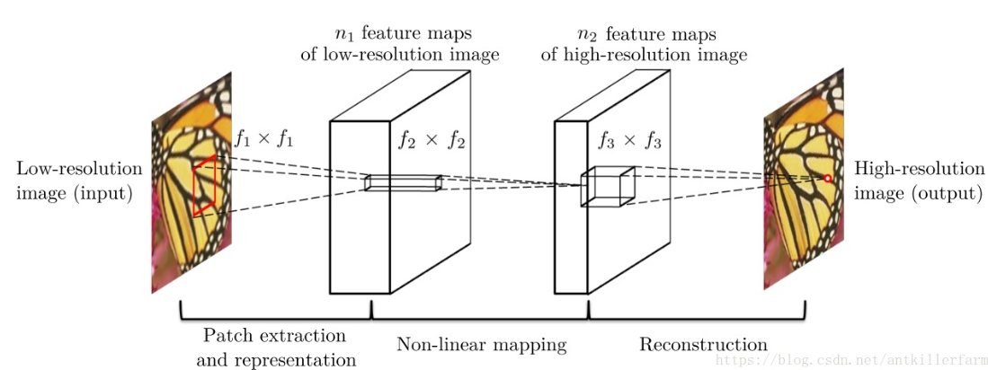
[Pre-upsampling SR] Example 1
SRCNN (商汤科技联合创始人汤晓鸥小组的Chao Dong的作品)
Dong, Chao, et al. "Learning a deep convolutional network for image super-resolution." European conference on computer vision. Springer, Cham, 2014.

Slide 8
 | Pros | Cons
Post-upsampling SR | Due to the fact that the feature extraction process through nonlinear convolutions with huge computational cost only occurs in low-dimensional space and the reso- lution increases only at the very end of the network, the computation complexity and spatial complexity is much reduced, and it also brings considerably faster training speed and inference speed. | the upsampling operation is performed in only one step, which greatly increases the learning difficulty for large scaling factors (e.g., 4, 8). each scaling factor requires an individual SR model, which cannot cope with the need for multi-scale SR.

Slide 9
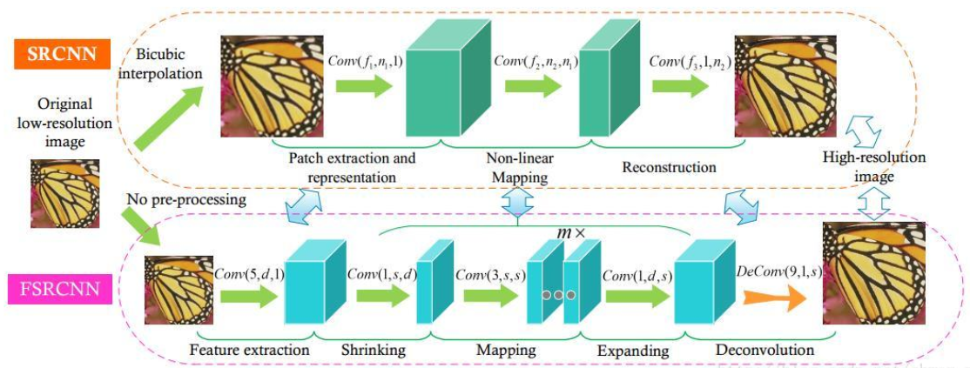
[Post-upsampling SR] Example 1
FSRCNN (商汤科技联合创始人汤晓鸥小组的Chao Dong的作品)
Dong, Chao, Chen Change Loy, and Xiaoou Tang. "Accelerating the super-resolution convolutional neural network." European conference on computer vision. Springer, Cham, 2016.
Comparison between SRCNN and FSRCNN

Slide 10
 | Pros | Cons
Progressive upsampling SR (e.g. LapSRN, MS-LapSRN, ProSR) | By decomposing a difficult task into simple tasks, the models under this framework not only greatly reduce the learning difficulty and obtain better performance, especially with large factors, but also cope with the multi-scale super- resolution problem without introducing overmuch spacial and temporal cost. because of the specific multi-stage design of the framework, some specific learning strategies such as curriculum learning and multi-chaneel supervision can be integrated to further reduce learning difficulty and improve final performance. | these models also encounter some problems, such as the complicated model designing for multiple stages and the training difficulty, so more instructional structure designing guidance and more advanced training strategies are needed.

Slide 11
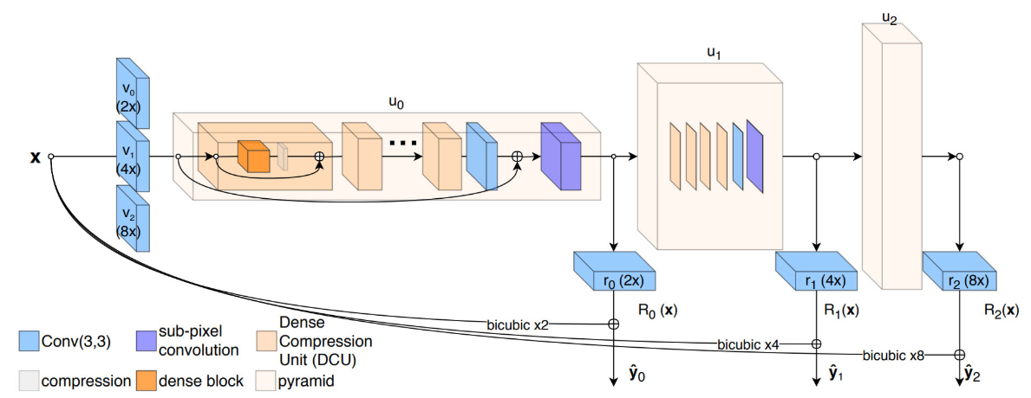
[Progressive upsampling SR] Example 1
ProSR
Wang, Yifan, et al. "A fully progressive approach to single-image super-resolution." Proceedings of the IEEE Conference on Computer Vision and Pattern Recognition Workshops. 2018.

Slide 12
 | Pros | Cons
Post-upsampling SR (e.g. DBPN) | The models under this framework can better mine the deep relationships between LR-HR image pairs and thus provide higher-quality reconstruction results. | the design criteria of the back-projection modules are still unclear. In fact, the back-projection units used in DBPN have a very complicated structure and require heavy manual design.
Notes:
This SR framework, namely iterative up-and-down sampling SR, tries to iteratively apply back-projection refinement, i.e., computing the reconstruction error then fusing it back to tune the HR image intensity

Slide 13
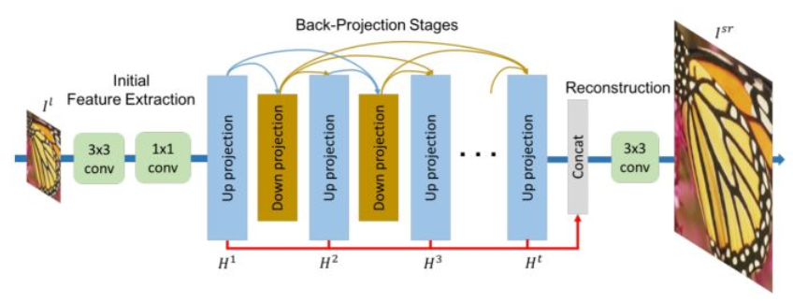
[Iterative up-and-down scaling SR] Example 1
DBPN (Winner of NTIRE 2018)
Haris, Muhammad, Gregory Shakhnarovich, and Norimichi Ukita. "Deep back-projection networks for super-resolution." Proceedings of the IEEE conference on computer vision and pattern recognition. 2018.

Slide 14
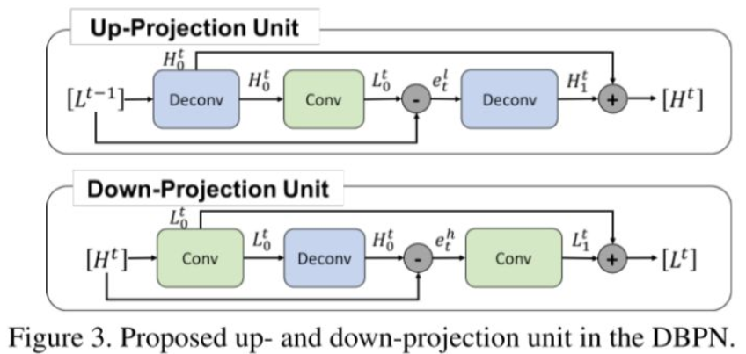
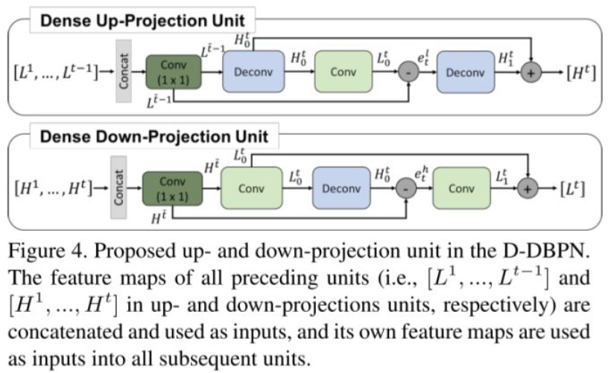
[Iterative up-and-down scaling SR] Example 1
DBPN (Winner of NTIRE 2018) (Cont’d)
Haris, Muhammad, Gregory Shakhnarovich, and Norimichi Ukita. "Deep back-projection networks for super-resolution." Proceedings of the IEEE conference on computer vision and pattern recognition. 2018.

Slide 15
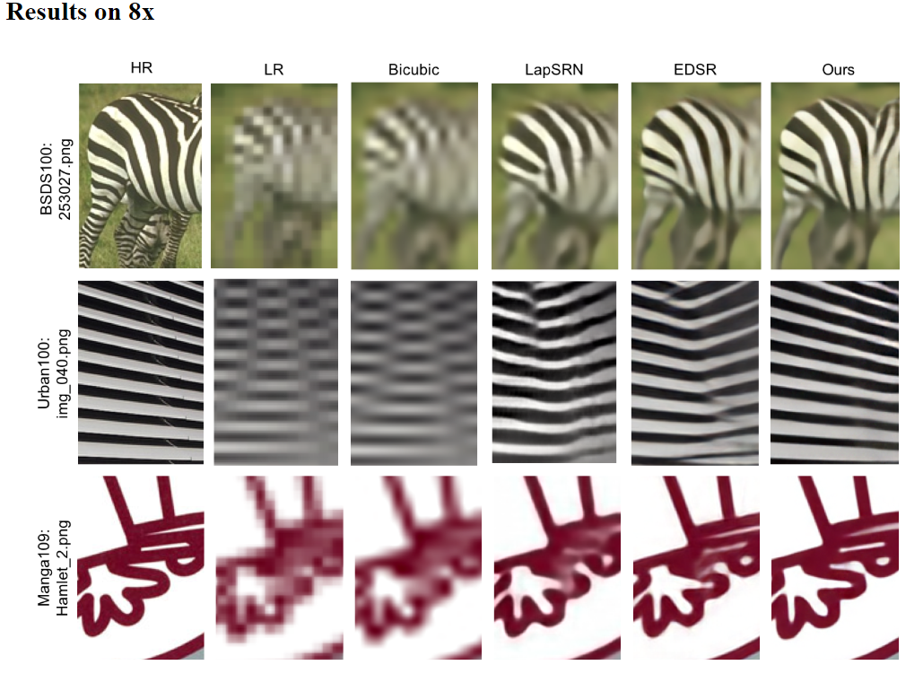
[Iterative up-and-down scaling SR] Example 1
DBPN (Winner of NTIRE 2018) (Cont’d)

Slide 16
Upsampling Methods

Slide 17
Upsampling Methods
Interpolation-based upsampling
Nearest-neighbor interpolation
Bilinear interpolation
Bicubic interpolation
Learning-based upsampling
Transposed convolution layer
Subpixel layer
Cons of interpolation-based upsampling methods:
the interpolation-based upsampling methods improve the image resolution only based on its own contents, which doesn’t bring any more information.
Instead, they often introduce some side effects into the SR models, such as computational complexity, noise amplification, blurring results

Slide 18
Upsampling Methods
Interpolation-based upsampling
Nearest-neighbor interpolation
Bilinear interpolation
Bicubic interpolation
Learning-based upsampling
Transposed convolution layer
Subpixel layer
Nowadays, these two learning-based layers have become the most widely used upsampling methods. Especially in the post-upsampling framework, these layers are usually used in the final upsampling phase for reconstructing HR images based on high-level features extracted in low-dimensional space, and thus achieve end-to- end SR while avoiding overwhelming operations in high- dimensional space.

Slide 19
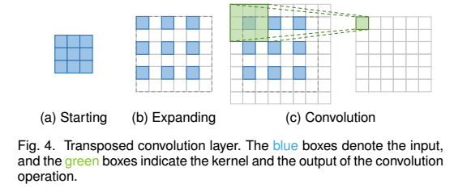
Transposed Convolution
it improves the image resolution by expanding the image by inserting zero values and performing convolution.
Also known as the deconvolution layer

Slide 20
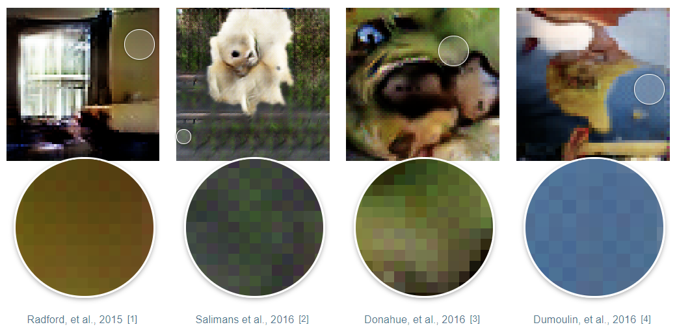
 | Pros | Cons
Transposed convolution | Since the transposed convolution layer can enlarge the image size in an end-to-end manner while maintaining a connectivity pattern compatible with vanilla convolution, it is widely used as the upsampling layer in SR models | This layer can easily cause “uneven overlapping” on each axis, and the multiplied results on both axes further create a characteristic checkerboard- like pattern of varying magnitudes and thus hurt the SR performance
A. Odena, V. Dumoulin, and C. Olah, “Deconvolution and checkerboard artifacts,” Distill, 2016.

Slide 21
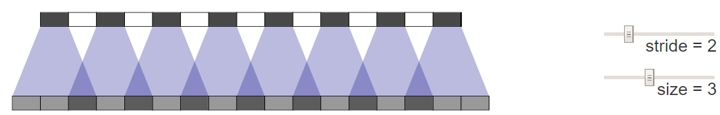
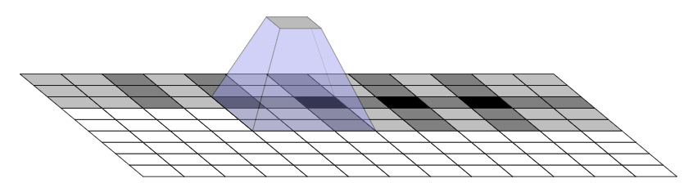
1D case
2D case
A. Odena, V. Dumoulin, and C. Olah, “Deconvolution and checkerboard artifacts,” Distill, 2016.

Slide 22
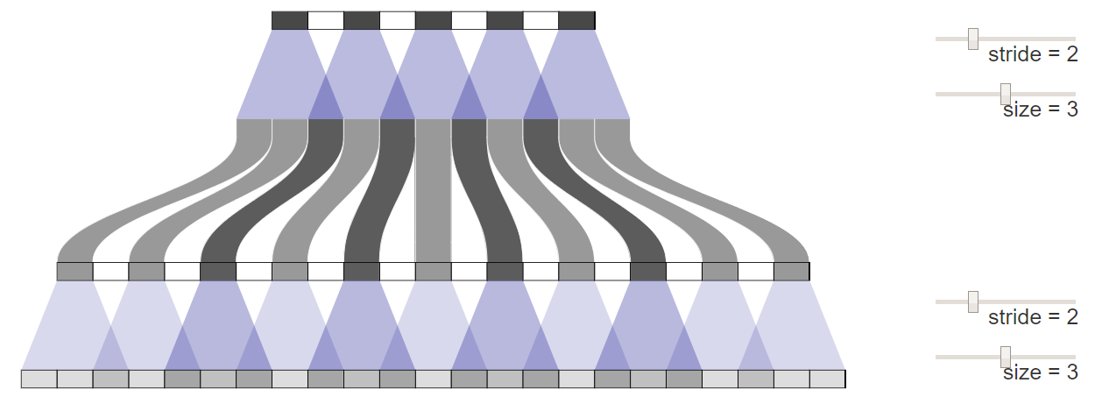
The artifact is propagated
A. Odena, V. Dumoulin, and C. Olah, “Deconvolution and checkerboard artifacts,” Distill, 2016.

Slide 23
Possible ways to avoid such artifact
In theory, our models could learn to carefully write to unevenly overlapping positions so that the output is evenly balanced. However, this is a tricky balancing act to achieve, especially when one has multiple channels interacting. Avoiding artifacts significantly restricts the possible filters, sacrificing model capacity. In practice, neural networks struggle to learn to completely avoid these patterns.
One approach is to make sure you use a kernel size that is divided by your stride, avoiding the overlap issue. This is equivalent to “sub-pixel convolution,” a technique which has recently had success in image super-resolution. However, while this approach helps, it is still easy for deconvolution to fall into creating artifacts.
Another approach is to separate out upsampling to a higher resolution from convolution to compute features. For example, you might resize the image (using nearest-neighbor interpolation or bilinear interpolation) and then do a convolutional layer. This seems like a natural approach, and roughly similar methods have worked well in image super-resolution
A. Odena, V. Dumoulin, and C. Olah, “Deconvolution and checkerboard artifacts,” Distill, 2016.

Slide 24
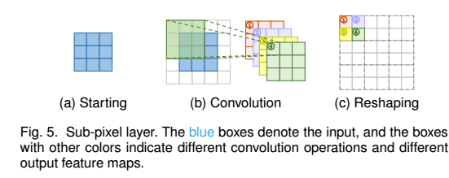
Subpixel Layer
The sub-pixel layer performs upsampling by generating a plurality of channels by convolution and then reshaping them

Slide 25
 | Pros | Cons
Subpixel Layer | Compared with transposed convolution layer, the greatest advantage of sub-pixel layer is the larger receptive field, which provides more contextual information to help gen- erate more accurate details. | The distribution of the receptive fields of sub-pixel layers is uneven, blocky regions actually share the same receptive field, which may result in some artefacts near the boundaries of different blocks

Slide 26
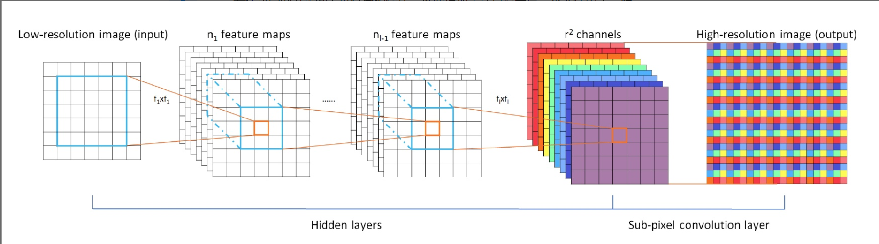
[Subpixel Layer] Example 1
ESPCN
Shi, Wenzhe, et al. "Real-time single image and video super-resolution using an efficient sub-pixel convolutional neural network." Proceedings of the IEEE conference on computer vision and pattern recognition. 2016.

Slide 27
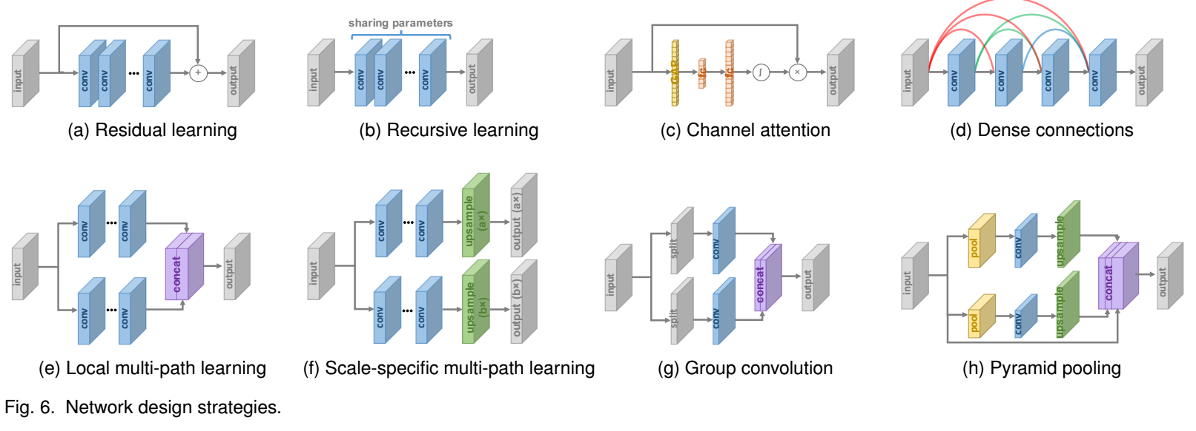
Network Design Strategy

Slide 28
Since super-resolution is an image-to-image translation task where the input image is highly correlated with the target image, researchers try to learn only the residuals between two images.
Global Residual Learning
Connect the input image and the output image
Local Residual Learning
Add multiple shortcuts between layers with different depths inside the network
Used to alleviate the degradation problem caused by ever-increasing network depths and improve the learning ability
It is widely used by SR models, especially under the pre-upsampling framework
Notes:
[28], [59], [60], [97]

Slide 29
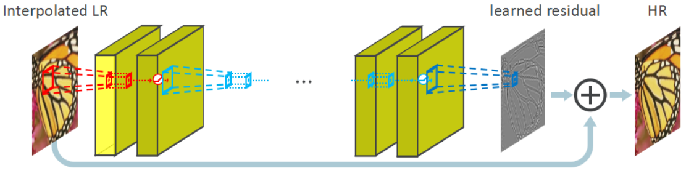
[Global Residual Learning] Example 1
VDSR
Kim, Jiwon, Jung Kwon Lee, and Kyoung Mu Lee. "Accurate image super-resolution using very deep convolutional networks." Proceedings of the IEEE conference on computer vision and pattern recognition. 2016.
The advantage of this framework is that the difficult upsampling task has been done by predefined traditional algorithms, and deep CNNs only need to refine the coarse images, which significantly reduces the learning difficulty. In addition, this model can take interpolated images with arbitrary size and scaling factors as input, and give refined results with comparable performance to single-scale SR models.

Slide 30
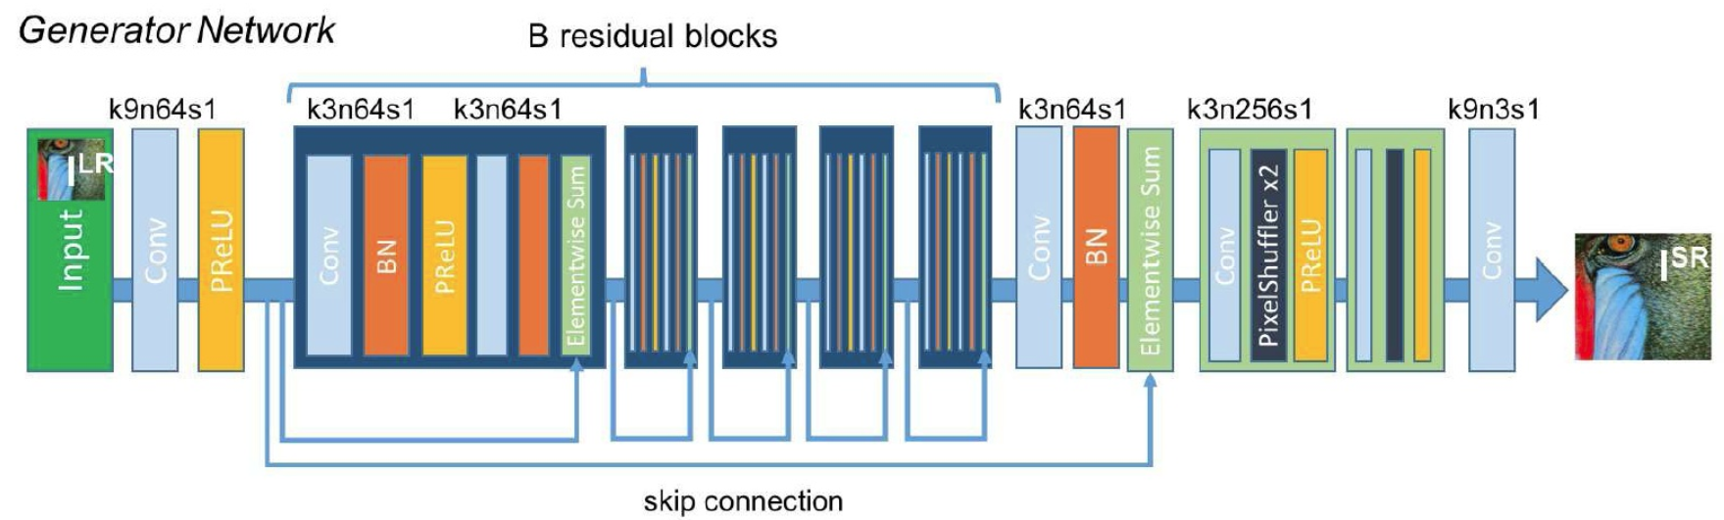
[Local Residual Learning] Example 1
SRResNet (Generator Network of SRGAN)
Ledig, Christian, et al. "Photo-realistic single image super-resolution using a generative adversarial network." Proceedings of the IEEE conference on computer vision and pattern recognition. 2017.

Slide 31
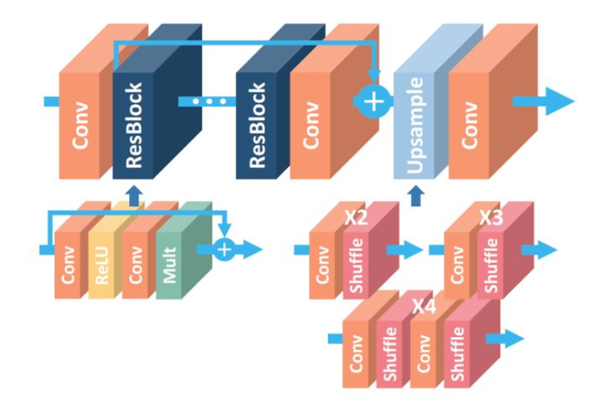
[Local Residual Learning] Example 2
EDSR [winner of NTIRE 2017]
Lim, Bee, et al. "Enhanced deep residual networks for single image super-resolution." Proceedings of the IEEE Conference on Computer Vision and Pattern Recognition Workshops. 2017.
Lim et al. argue that the BN loses the scale information of each image and gets rid of range flexibility from networks. So they remove BN layers, use the saved memory (up to 40%) to employ a much larger model, and thus increase the performance substantially.

Slide 32
Recursive learning is designed to achieve larger receptive field and learn higher- level features without introducing overwhelming parameters
apply the same modules multiple times in a recursive manner
Examples:
DRCN employs a single convolutional layer as the recursive unit and reaches a receptive field of 41×41, which is much larger than 13×13 of SRCNN, without over many parameters.
DRRN uses a residual block as the recursive unit for 25 recursions and obtains even better performance than a non- recursive baseline with 17 residual blocks. Later
MemNet based on the memory block, which is composed of a 6-recursive residual block where the outputs of every recursion are concatenated and go through an extra 1 × 1 convolution for memorizing and forgetting.
CARN also adopts a similar recursive unit including several residual blocks.
In practice, recursive learning inherently brings vanishing or exploding gradient problems, consequently some techniques such as residual learning and multi- supervision are often combined together with recursive learning for mitigating these problems
Notes:
DRCN[80], DRRN [60], MemNet [59], CARN [30]

Slide 33
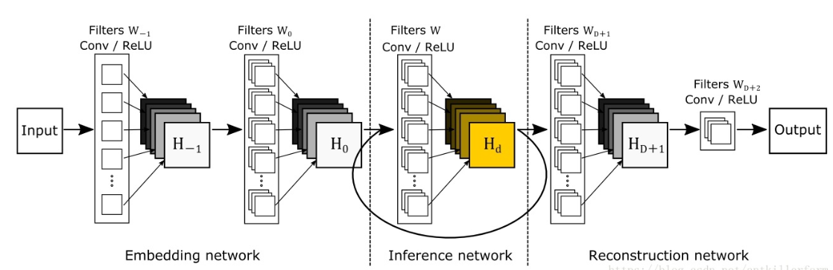
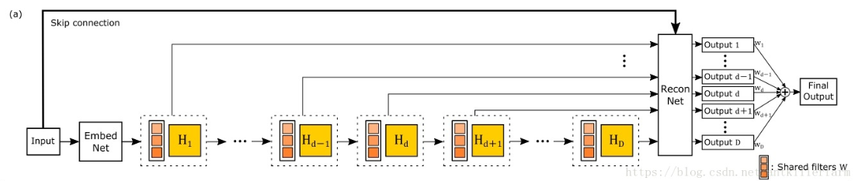
Examples
DRCN (Deeply-Recursive Convolutional Network for Image Super-Resolution)
Kim, Jiwon, Jung Kwon Lee, and Kyoung Mu Lee. "Deeply-recursive convolutional network for image super-resolution." Proceedings of the IEEE conference on computer vision and pattern recognition. 2016.

Slide 34
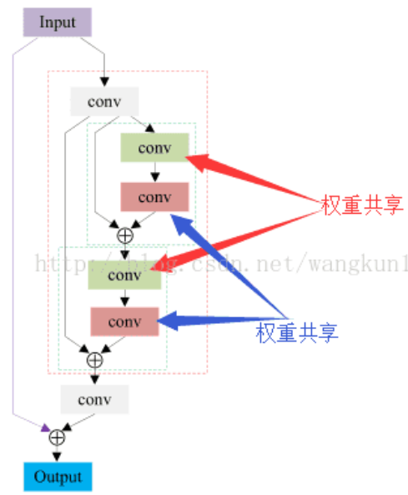
Example 2
DRRN (Image Super-Resolution via Deep Recursive Residual Network)
Tai, Ying, Jian Yang, and Xiaoming Liu. "Image super-resolution via deep recursive residual network." Proceedings of the IEEE Conference on Computer vision and Pattern Recognition. 2017.

Slide 35
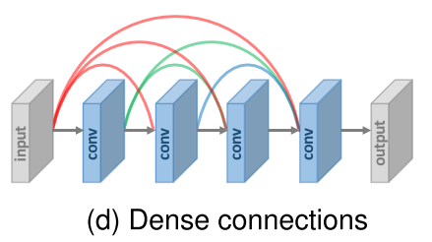
The dense connections help
alleviate gradient vanishing
enhance signal propagation
encourage feature reuse
substantially reduce the number of parameters by employing small growth rate (i.e., number of channels in dense blocks) and squeezing channels after concatenation

Slide 36
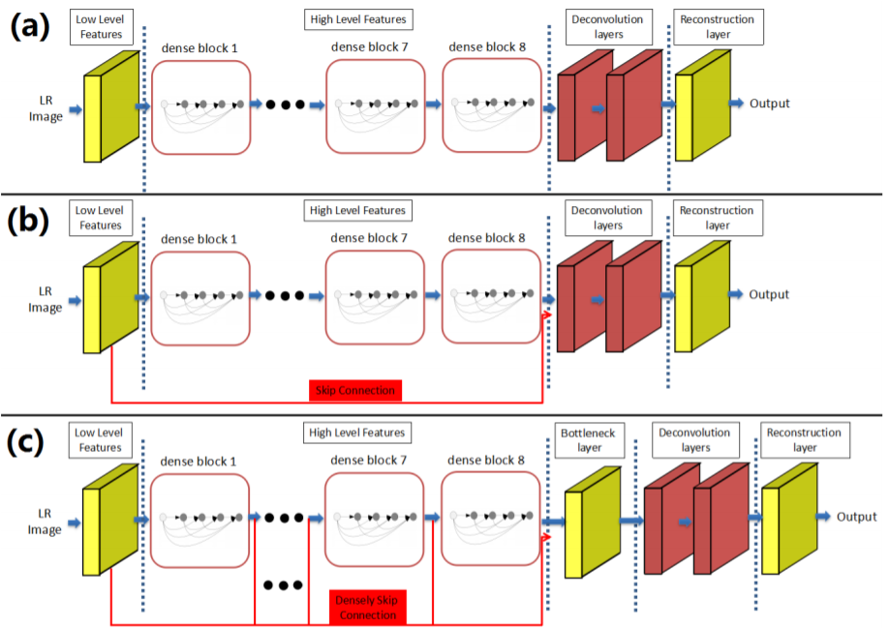
[Dense Connection] Example 1
SRDenseNet
Tong, Tong, et al. "Image super-resolution using dense skip connections." Proceedings of the IEEE International Conference on Computer Vision. 2017.
Tong et al. not only adopt dense blocks to construct a 69-layers SRDenseNet, but also insert dense connections between different dense blocks, i.e., for every dense block, the feature maps of all preceding blocks are used as inputs, and its own feature maps are used as inputs into all subsequent blocks.

Slide 37
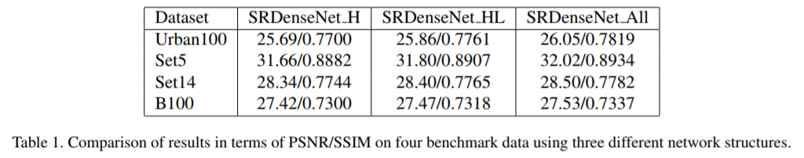
[Dense Connection] Example 1
SRDenseNet (Cont’d)

Slide 38
Multi-path learning refers to passing features through multiple paths of the model, which perform different operations, for providing better modelling capabilities.
Global Multi-path Learning
make use of multiple paths to extract features of different aspects of the images. These paths can cross each other in the propagation and thus greatly enhance the ability of feature extraction (e.g. LapSRN, DSRN).
Local Multi-path Learning (see the figure above)
Scale-specific Multi-path Learning (see the figure above)

Slide 39
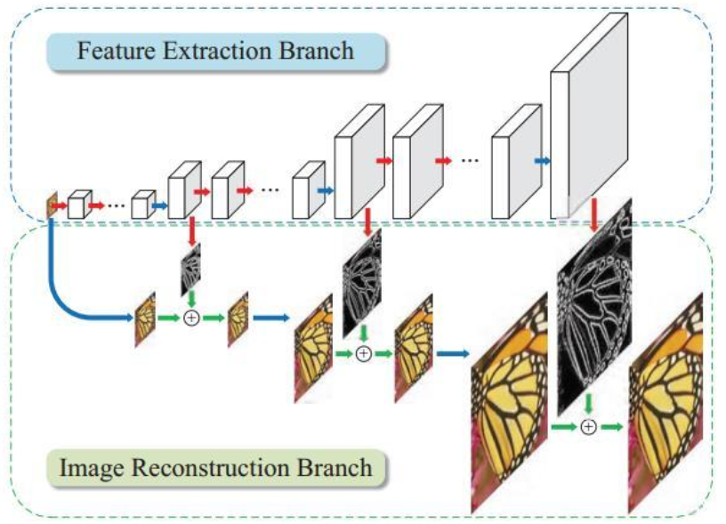
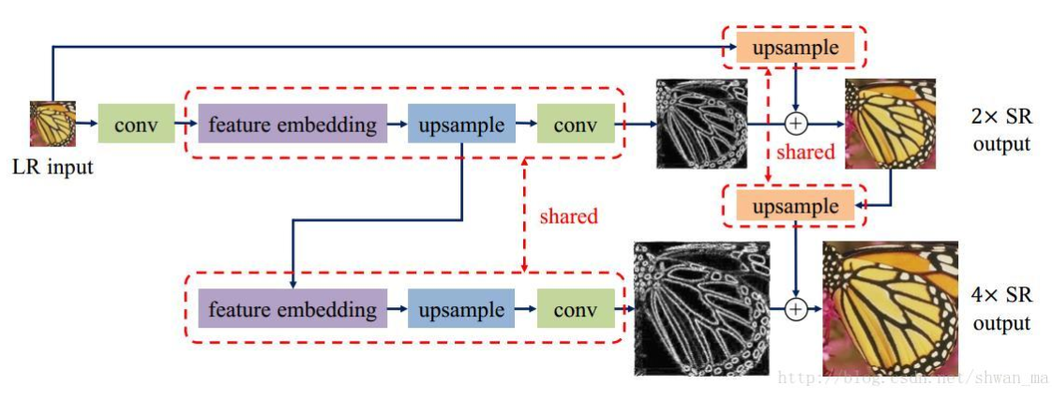
[Global Multi-path Learning] Example 1
LapSRN
Lai, Wei-Sheng, et al. "Fast and accurate image super-resolution with deep laplacian pyramid networks." IEEE transactions on pattern analysis and machine intelligence (2018).
The LapSRN includes a feature extraction path predicting the sub-band residuals in a coarse-to-fine fashion, and an image reconstruction path to reconstruct visible HR images based on the information streams of both paths.
Progressive Upsampling (2-path learning)
Recursive Learning
Notes:
1. 本文是通过将低分辨率图像直接作为输入到网络中，通过逐级放大，在减少计算量的同时，也有效的提高了精度
2. 提出了一种鲁棒的loss function, robust Charbonnier loss function.
3. 对各个金字塔的level之间和每个level之内，通过recursive进行参数共享
---------------------
作者：Shwan_Ma
来源：CSDN
原文：https://blog.csdn.net/shwan_ma/article/details/78690974
版权声明：本文为博主原创文章，转载请附上博文链接！

Slide 40
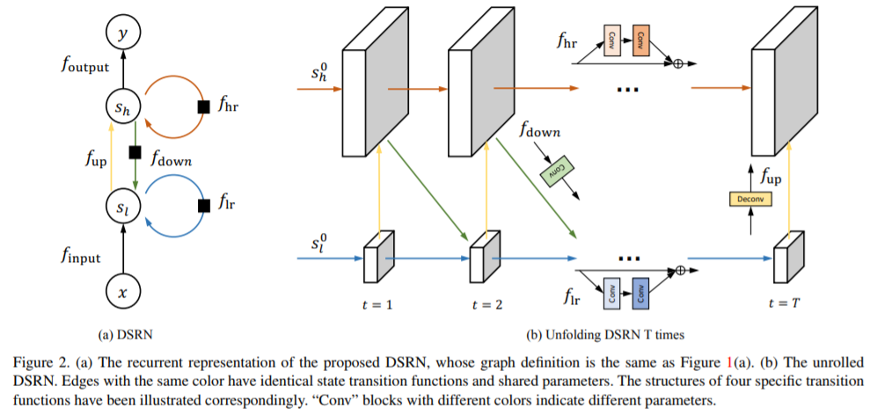
[Global Multi-path Learning] Example 2
DSRN
Han, Wei, et al. "Image super-resolution via dual-state recurrent networks." Proceedings of the IEEE Conference on Computer Vision and Pattern Recognition. 2018.
The DSRN utilizes an LR path and an HR path to extract in- formation in low-dimensional space and high-dimensional space, respectively. These two paths continuously exchanging information for further improving learning ability.

Slide 41
Part II
Channel Attention/Dilate Convolution/Group Convolution

Slide 42
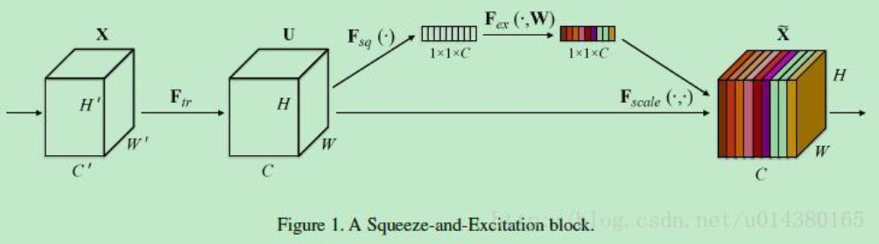
The channel attention is designed to considering the interdependence and interaction of the feature representations between different channels.
Inspired by SENet (first place in ILSVRC 2017 分類比賽): Hu et al. propose a “squeeze-and-excitation” block to improve representation ability by explicitly modelling channel inter-dependence
Notes:
SENet的核心思想在于通过网络根据loss去学习特征权重，使得有效的feature map权重大，无效或效果小的feature map权重小的方式训练模型达到更好

Slide 43
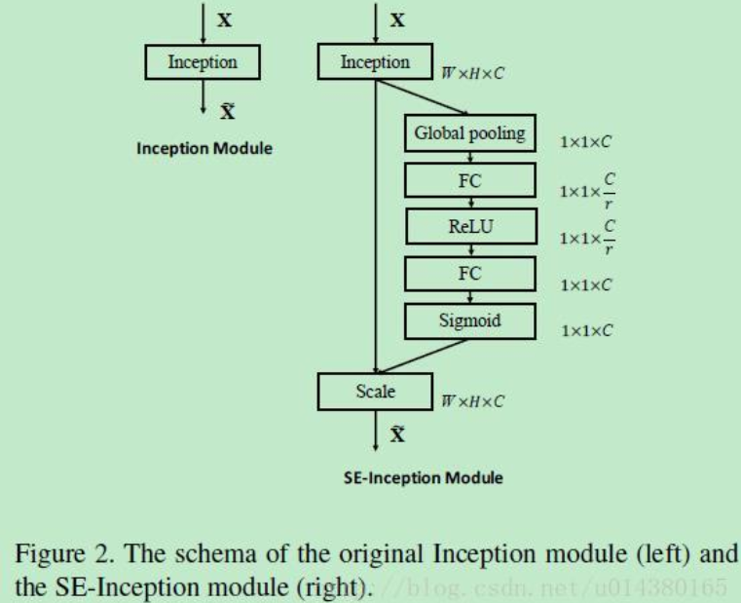
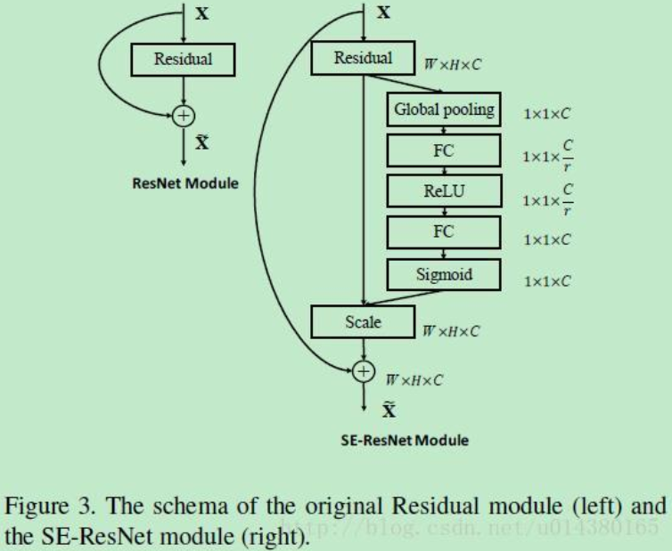
More on SENet
SE-Inception module
SE-ResNet module

Slide 44
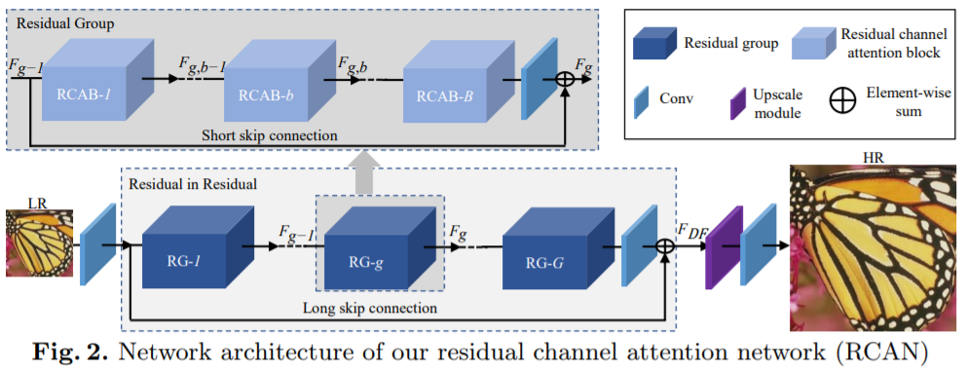
[Channel Attention] Example 1
RCAN
Zhang, Yulun, et al. "Image super-resolution using very deep residual channel attention networks." Proceedings of the European Conference on Computer Vision (ECCV). 2018.
Zhang et al. firstly incorporate the attention channel into super-resolution and propose RCAN, which markedly improves the representation ability of the model and advances the SR performance.

Slide 45
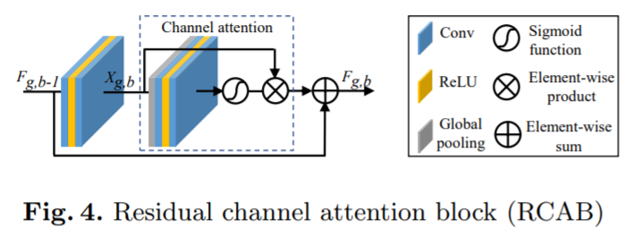
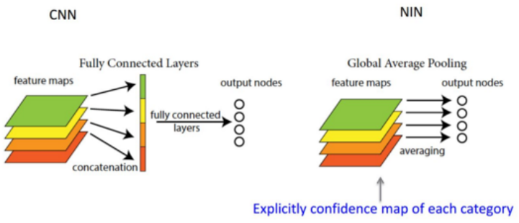
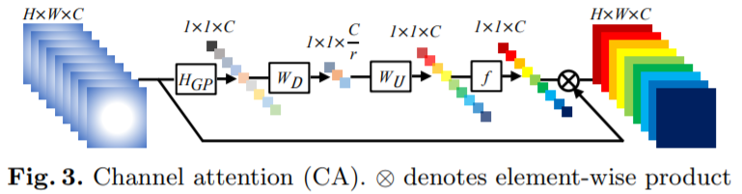
[Channel Attention] Example 1
RCAN (Cont’d)

Slide 46
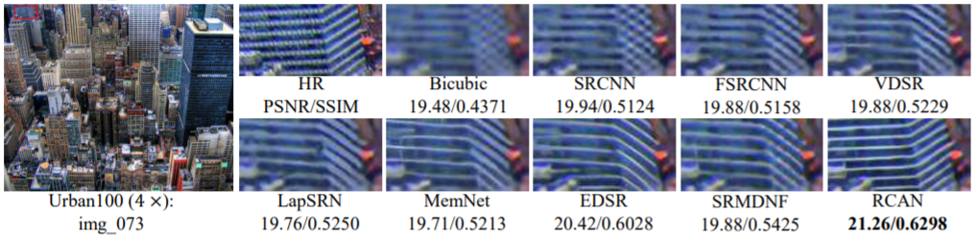
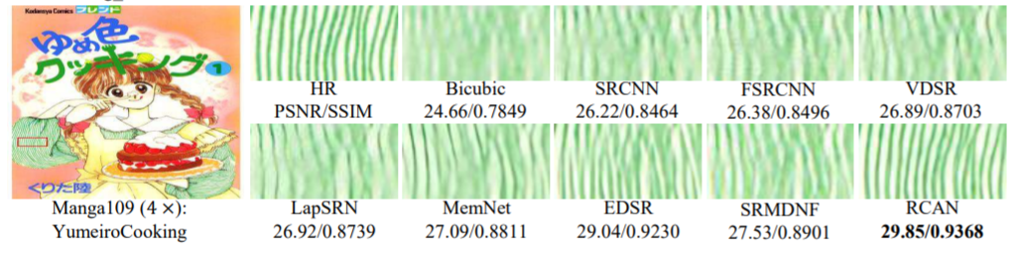
[Channel Attention] Example 1
RCAN (Cont’d)

Slide 47
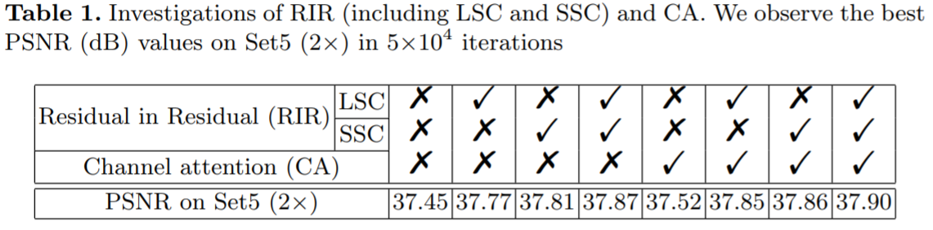
[Channel Attention] Example 1
RCAN (Cont’d)

Slide 48


Advanced Convolution
Dilated Convolution
Dilated/Atrous Convolution 或者是 Convolution with holes 从字面上就很好理解，是在标准的 convolution map 里注入空洞，以此来增加 reception field。相比原来的正常convolution，dilated convolution 多了一个 hyper-parameter 称之为 dilation rate 指的是kernel的间隔数量(e.g. 正常的 convolution 是 dilatation rate 1)。
Notes:
然而 Deep CNN 对于其他任务还有一些致命性的缺陷。较为著名的是 up-sampling 和 pooling layer 的设计。这个在 Hinton 的演讲里也一直提到过。
主要问题有：
Up-sampling / pooling layer (e.g. bilinear interpolation) is deterministic. (a.k.a. not learnable)
内部数据结构丢失；空间层级化信息丢失。
小物体信息无法重建 (假设有四个pooling layer 则 任何小于 2^4 = 16 pixel 的物体信息将理论上无法重建。)
在这样问题的存在下，语义分割问题一直处在瓶颈期无法再明显提高精度， 而 dilated convolution 的设计就良好的避免了这些问题。

Slide 49
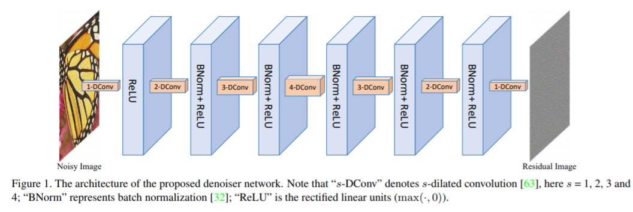
[Dilated Convolution] Example 1
Learning deep CNN denoiser prior for image restoration
Zhang, Kai, et al. "Learning deep CNN denoiser prior for image restoration." Proceedings of the IEEE Conference on Computer Vision and Pattern Recognition. 2017.
Zhang et al. replace the common convolution by dilated convolution in SR models, increase the receptive ﬁeld over twice and ﬁnally achieve much better performance.

Slide 50
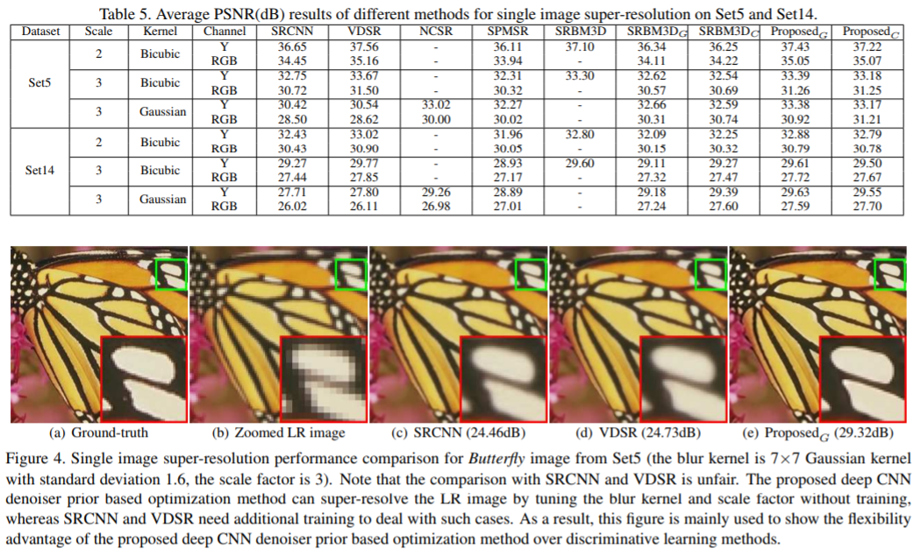
[Dilated Convolution] Example 1
Learning deep CNN denoiser prior for image restoration (Cont’d)
Results (Single Image Super-Resolution)

Slide 51
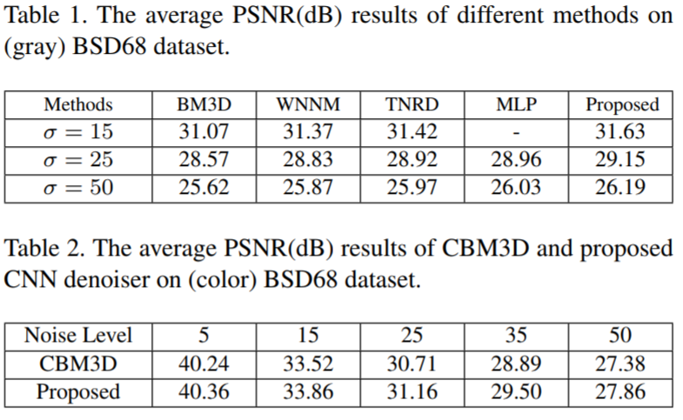
[Dilated Convolution] Example 1
Learning deep CNN denoiser prior for image restoration (Cont’d)
Results (Denoise)

Slide 52
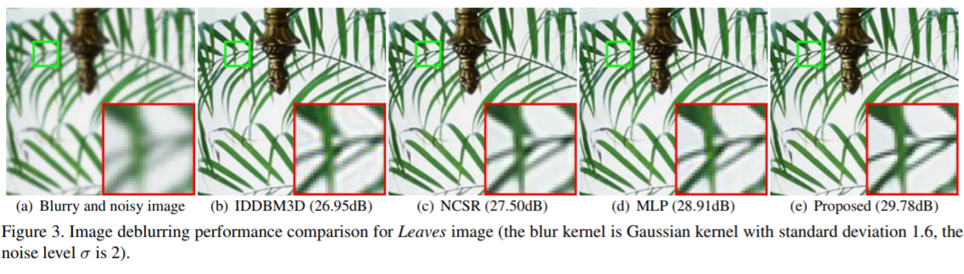
[Dilated Convolution] Example 1
Learning deep CNN denoiser prior for image restoration (Cont’d)
Results (Deblurring)

Slide 53
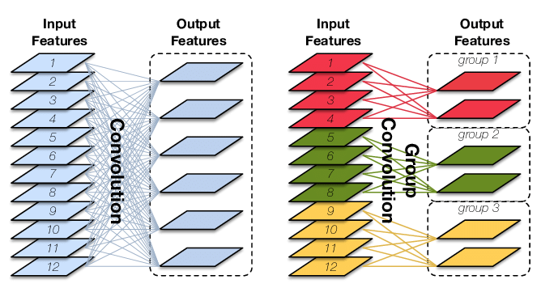
Advanced Convolution
Group Convolution
减少参数量，分成G组，则该层的参数量减少为原来的1/G
Group Convolution可以看成是structured sparse，每个卷积核的尺寸由C∗K∗K变为CG∗K∗K，可以将其余(C−CG)∗K∗K的参数视为0，有时甚至可以在减少参数量的同时获得更好的效果（相当于正则）。

Slide 54
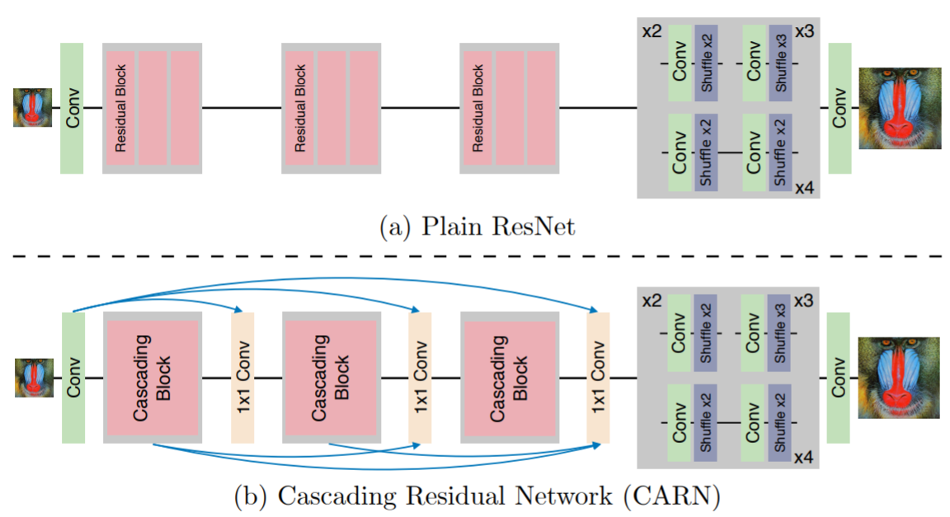
[Group Convolution] Example 1
CARN
Ahn, Namhyuk, Byungkon Kang, and Kyung-Ah Sohn. "Fast, accurate, and lightweight super-resolution with cascading residual network." Proceedings of the European Conference on Computer Vision (ECCV). 2018.
Ahn et.al design an architecture for super-resolution that implements a cascading mechanism upon a residual network to reduce the computation complexity.

Slide 55
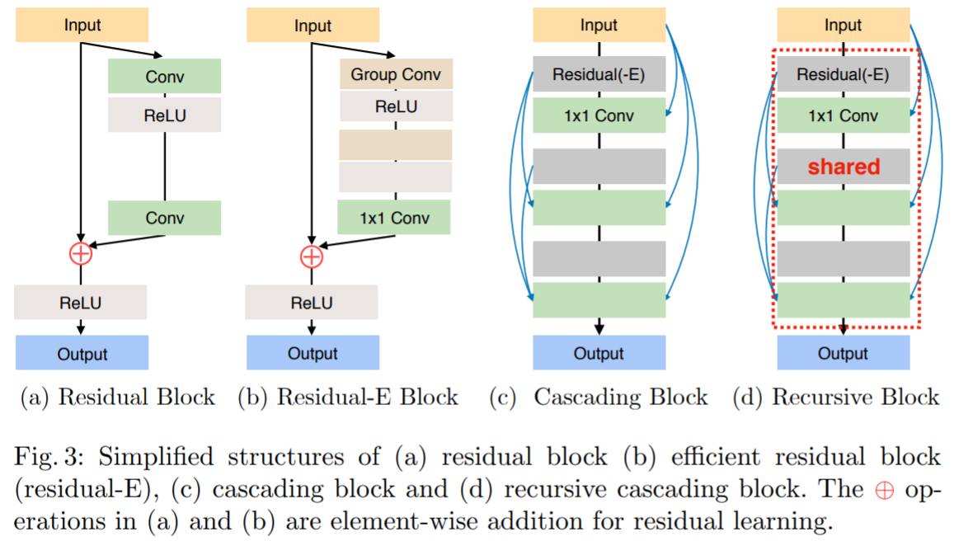
[Group Convolution] Example 1
CARN (Cont’d)
Notes:
Our CARN model is based on ResNet [14]. The main difference between CARN and ResNet is the presence of local and global cascading modules. Fig. 2 (b) graphically depicts how the global cascading occurs. The outputs of intermediary layers are cascaded into the higher layers, and finally converge on a single 1x1 convolution layer. Note that the intermediary layers are implemented as cascading blocks, which host local cascading connections themselves. Such local cascading operations are shown in Figure 2(c) and (d). Local cascading is almost identical to a global one, except that the unit blocks are plain residual blocks.

Slide 56
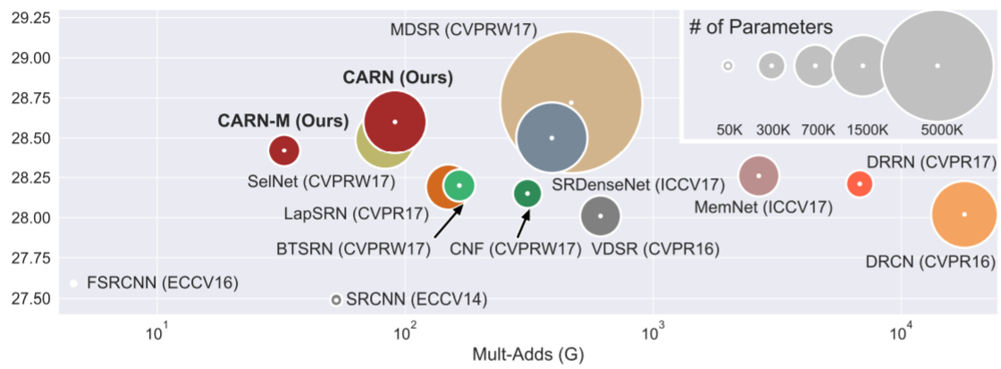
[Group Convolution] Example 1
CARN (Cont’d)
Results

Slide 57
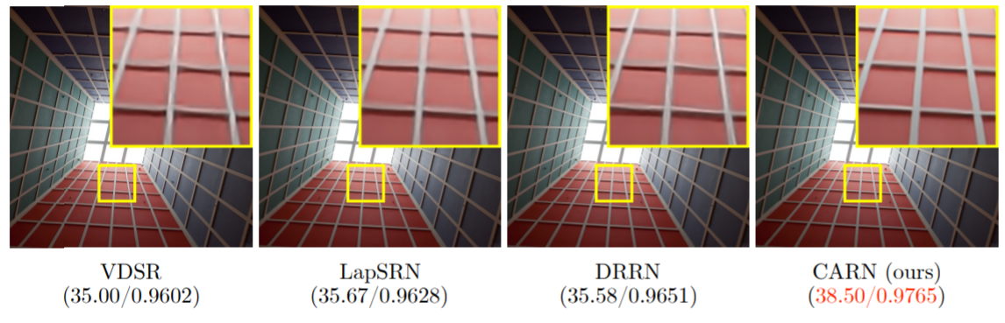
[Group Convolution] Example 1
CARN (Cont’d)
Results

Slide 58

[Group Convolution] Example 1
CARN (Cont’d)
Results

Slide 59

Pixel Recursive Learning
與最先進的方法相比，這篇論文提出了一種端到端的框架來完成超解析度任務。它由兩個卷積神經網絡組成，一個是描述低解析度圖像骨架的優先網絡（prior network），一個是用於優化細節特徵的調節網絡（conditioning network）。這種方法強調了細節特徵恢復上的提升，並以機率範式（probabilistic paradigm）的形式提升了其理論。
Dahl, Ryan, Mohammad Norouzi, and Jonathon Shlens. "Pixel recursive super resolution." Proceedings of the IEEE International Conference on Computer Vision. 2017.

Slide 60


Pixel Recursive Learning
Results

